Slide 1
Azure Mobile Services
Global Azure Services

Slide 2
Outline
Azure Data
Scripts – Custom Api
Android Project
Push Notification
Monitoring
Automation
Whats new with Mobile Apps

Slide 3
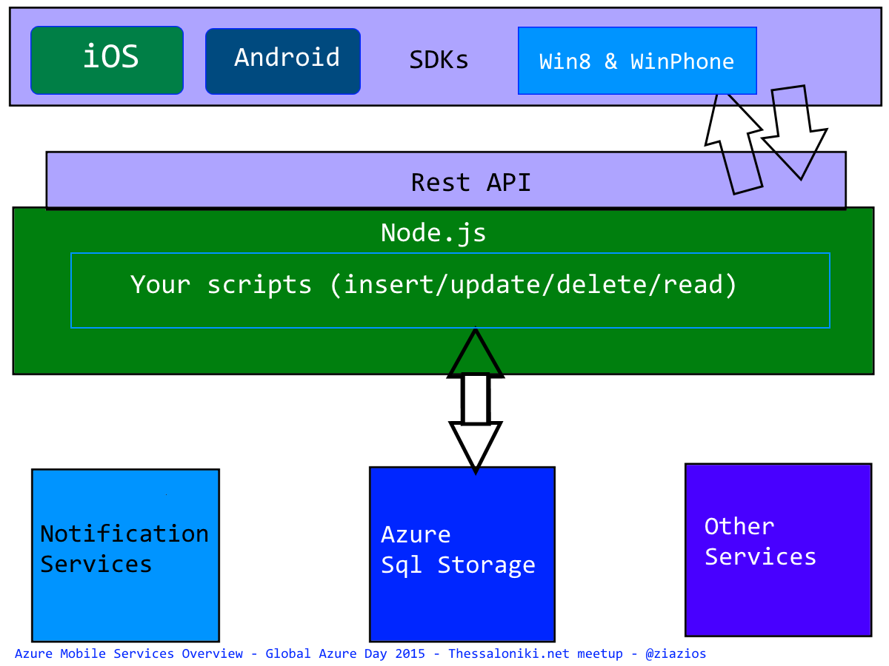
Architecture

